Slide 1
IMSE 991 Multiple Criteria Decision Making
Lecture 11
Strategic Planning and New Product Development

Slide 2
Strategic Planning and New Product Development
Introduction
Key Concepts
System Implementation

Slide 3
Strategic Planning and New Product Development
Introduction
Development of a strategic planning model for a large international firm to select new products for the future of their company.
Good example of the process for developing an overall decision model.
The system was used to systematically manage and evaluate business and/or new product opportunities from conception to commercialization.

Slide 4
Strategic Planning and New Product Development
Introduction
Relies on using Multiple Criteria Decision Making methodologies with trades-off of the various decision criteria to obtain the best strategy. .
Decision makers from various levels of the organization were involved in establishing the goals and objectives of the organization.
The goals and objectives were then translated into decision criteria and metrics that could be used to measure the success of meeting the organizational goals.

Slide 5
Strategic Planning and New Product Development
Introduction
Decision tool was created to aid in evaluating development programs through five stages of implementation.
A number of criteria that were scored for each program.
The criteria were then weighted and used to rank all of the development programs.

Slide 6
Strategic Planning and New Product Development
The criteria used included:
MARKET (type of market, and potential sales volume)
FINANCE (net present value, cash flow streams, life cycle and payout)
RESOURCES (what physical resources are required, e.g., building and equipment and staffing)
PROBABILITY OF SUCCESS (1 - 100% estimated probability of meeting all expectations)
STRATEGIC ALIGNMENT (Does this prospective opportunity complement current business activities and are their any barriers (patents), protection or technology that the organization possesses to insure success).

Slide 7
Strategic Planning and New Product Development
Multiple Criteria Ranking Methodology
The ranking used a prioritization methodology (TOPSIS)
This methodology is based on the relationships between the criteria and their values and the criteria weights.
The ranking model was a hierarchical design since most of the top-level criteria have sub-criteria grouped underneath them.

Slide 8
Strategic Planning and New Product Development
Sensitivity Analysis
The decision support system had the capability to calculate the sensitivity of each criteria input.
The system calculated the amount each criteria must change to move that specific program up one rank or down one rank on the list.

Slide 9
Strategic Planning and New Product Development
Key Graphs
A graphing section was included that graphed the Net Present Value against the Probability of Commercial Success.
This showed graphically the most profitable combination of programs for the business.

Slide 10
Strategic Planning and New Product Development
The Decision Support System
The system was built as an evaluation tool at each stage in the five stage-gate process from program conception to commercialization.
At each gate in the process, the programs were evaluated using different criteria and different weights on the criteria.
The gate authorization of each program was set as the program progresses through the development stages.

Slide 11
Strategic Planning and New Product Development
The Decision Support System
Tracked developmental progress of current business and/or new product opportunities.
Eliminated un-profitable business and/or new products at the earliest possible point in the developmental phases.
Generated a prioritized business and/or new product opportunity listing.
Utilized discipline and consistency in evaluating each business and/or new product opportunity.
Calculated the sensitivity of each criteria value to determine the impact of a change in the data.

Slide 12
Strategic Planning and New Product Development
The Main Menu options included in the decision model are shown below:
A: Input/Edit Data – Data input for programs
B: Criteria Weights – Weighting of criteria to represent their importance in the decision
C: Run Ranking – Methodology used to rank programs
D: View/Sort Inputs and Results – User interface to view input and results
E: Print Reports – User interface to print reports
F: Save/Retrieve Files – Data upload capabilities
G: Sensitivity Analysis – Perform sensitivity analysis on the data and the decisions
H: Graph NPV vs Commercial Success – Analytical representation of ranking results

Slide 13
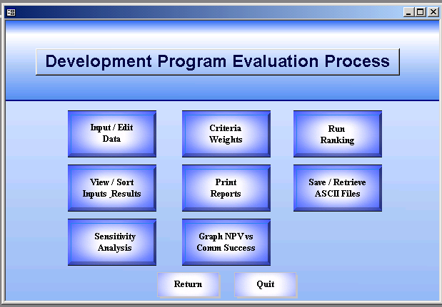

Slide 14
Strategic Planning and New Product Development
Input/Edit Data
Significant work was performed to identify the goals and objectives of the organization, develop the decision criteria that represent these goals and develop the metrics that were used to measure the merit of each of the programs.
Individuals from various levels of the organization were involved with establishing the higher-level criteria and subordinate level metrics used in the system.

Slide 15
Strategic Planning and New Product Development
Input/Edit Data
Data to support the model was assessed for availability and use in the model.
Certain parameters were also identified that would need to be calculated and maintained within the system.
A clear definition of the criteria used for the evaluation process provided users with the ability to consistently evaluate programs against one another.

Slide 16
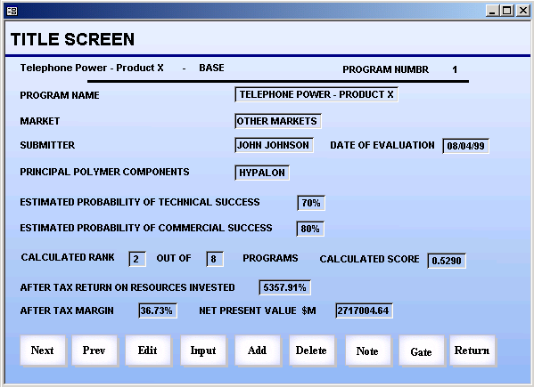

Slide 17
Strategic Planning and New Product Development
Two of the decision criteria used in the program ranking process, the Estimated Probability of Technical Success and the Estimated Probability of Commercial Success are also input.
Financial information regarding the program is shown on the screen including the After Tax Return on Resources Invested, the After Tax Margin and the Net Present Value.
The program ranking and the normalized ranking score relative to the other programs are also displayed on the title screen.
The five criteria values are for Market, Competitive Position, Resource, Finance and Strategic Alignment.

Slide 18
Strategic Planning and New Product Development
The six decision criteria are used to calculate the ranked program list.
A definition of the criteria used to evaluate each of the major criteria is shown and the scale used for the evaluation process.
Some of the criteria are objective and some are subjective.

Slide 19
Strategic Planning and New Product Development
Market Characteristic Input Data
Type of Market - This is the market where the program is expected to have a major impact. If the market is not determined yet select `other'.
Ability To Market - This criteria measures the ability to identify and reach the key purchase influencer. If the key influencer is known and we can reach him with a relatively small effort, select `5'. If the key influencer is unknown or very hard to reach, select `1'.

Slide 20
Strategic Planning and New Product Development
Market Characteristic Input Data
New or Existing Market - This criteria reflects the amount of effort required to build the market. If the required effort extends programs already underway in existing markets, select `5'. If the program requires a new marketing effort select `1'. Existing effort in new markets is rated a `3'.

Slide 21
Strategic Planning and New Product Development
Market Characteristic Input Data
Market Attractiveness - Attractive markets (rated `5') are sizable, profitable, growing and are relatively easy to establish a competitive advantage. Unattractive markets (rated `1') are low in size, growth and profits and are difficult to establish a competitive advantage. Low measurements in only one of these areas is rated an intermediate score.

Slide 22
Strategic Planning and New Product Development
Market Characteristic Input Data
Market Size or Potential - Size of potential market is measured as the maximum of attainable sales in the third year of commercial operation. Rate the size of the market in the third year of full commercial operation.

Slide 23
Strategic Planning and New Product Development
Market Characteristic Input Data
Market Growth Potential - Rate the growth of the market for only the portion of the market that we can reasonably expect to capture. The expected market opportunity is the market opportunity functionality and cost considered (MOFCC).

Slide 24
Strategic Planning and New Product Development
Market Characteristic Input Data
Number of Potential Customers - High number of potential customers who will be interested in the proposed offering is rated `5'. If only a few customers (2 or 3) are interested in the offering, the rating is `1'.

Slide 25
Strategic Planning and New Product Development
Market Characteristic Input Data
Profitability of Customers - Highly profitable customers are more likely to desire value added offerings, and less likely to ask us to price compete (a rating of `5'). Unprofitable customers ignore value added offerings and insist on price competition among suppliers (a rating of `1').

Slide 26
Strategic Planning and New Product Development
Market Characteristic Input Data
Customer Satisfaction - Customers who are well satisfied with current offerings are less likely to accept substitutes (rating of `1'). Low satisfaction (rating of `5') indicates higher probability of substitute acceptance. It considers the willingness of customers to switch to a new offering.

Slide 27
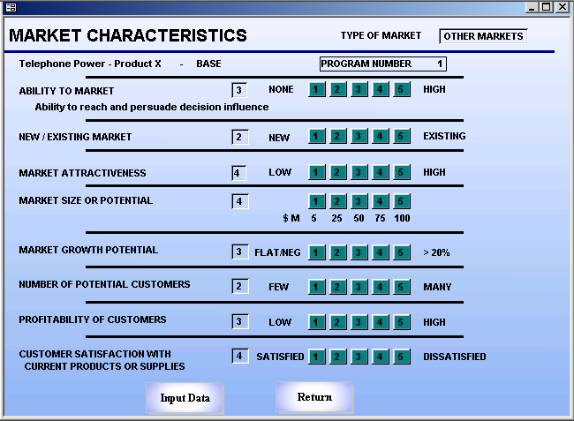

Slide 28
Strategic Planning and New Product Development
Competitive Position Input Data
Size of Competitive Barriers - Most attractive opportunities (rating `5') achieve barriers which prevent competitive copying. An unattractive opportunity (e.g., a price cut) is easily copied and is rated `1'.

Slide 29
Strategic Planning and New Product Development
Competitive Position Input Data
Sustainability of Barriers - The longer the competitive barriers can be sustained the better - e.g., 5+ years - might be rated `5'.
Competitors Attacked - Attacking and tying up key competitors is an advantage.

Slide 30
Strategic Planning and New Product Development
Competitive Position Input Data
Intensity of Competition - Rate the level of competition. Heavy (rating `1') competition implies many competitors, all-jockeying for position with no clear leader. Light competition is characterized by few competitors and a stable competitive environment.

Slide 31
Strategic Planning and New Product Development
Competitive Position Input Data
Opportunity to Obtain Price Premium - Rate our ability to differentiate our product and our ability to get a price premium. High ability is characterized by clear customer preference and above market (+10% at least) price. No opportunity is characterized by intense competitive pricing.

Slide 32
Strategic Planning and New Product Development
Competitive Position Input Data
Product Advantage - Rate the amount of product advantage the program create versus competitive offerings. A high rating implies significant advantage for a customer to switch to our new initiative.

Slide 33
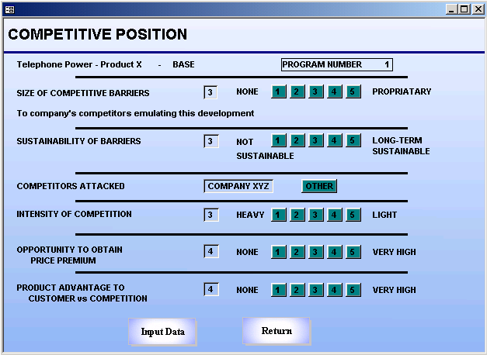

Slide 34
Strategic Planning and New Product Development
Resource Input Data
Technical Development Requirements - Rate the level of new technical effort required for the product development. 4 = None, 3 = Slight Modification of Existing Technology, 2 = Major Modification of Existing Technology and 1 = New Invention Required.

Slide 35
Strategic Planning and New Product Development
Resource Input Data
Market Resource Requirements - Rate the level of investment of resources required to achieve market presence. 5 = Minor. Implies existing resources can handle the new program readily. 4 = Moderate Increment to Staff, 3 = Small Increment to Staff (less than two people), 2 = Moderate Increment to Staff (two to five people), 1 = Major Increment to Staff (greater than five people)

Slide 36
Strategic Planning and New Product Development
Resource Input Data
Fits Our Production Process/Equipment - An attractive project builds out on facilities already in place and is rated `5'. If new production processes are required, the rating is `1'. Relatively minor additions are rated `3'.

Slide 37
Strategic Planning and New Product Development
Resource Input Data
Builds on One of Our Strengths – Indicate the strength this program builds on. The current strengths of Technology, Marketing, Manufacturing or Other Strengths.

Slide 38
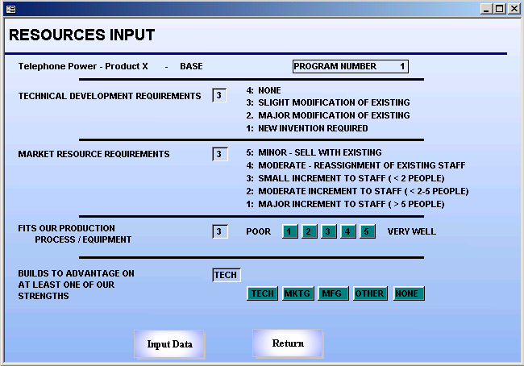

Slide 39
Strategic Planning and New Product Development
Financial Input Data
Year to First Revenue Flow – Enter the first year of revenue flow from commercial success of this program. Earlier flows are preferred over later flows.
Number of Years to Last Revenue Flow – This is the length of expected benefit from this program’s commercial success. Consider the impact of competitive activity when estimating the commercial flow. These above two criteria are a way to estimate the life cycle of the project or product.

Slide 40
Strategic Planning and New Product Development
Financial Input Data
Net Present Value - The system was developed so that there were two ways to input the net present value (NPV), directly (if the cash flows have already been discounted) or using a worksheet developed within the system to discount them. In the current computing environment, Microsoft Excel contains the capabilities to perform these calculations and link them to the system being used.

Slide 41
Strategic Planning and New Product Development
Financial Input Data
Also enter:
After Tax Margin as percent
After Tax Return as percent
Discount Rate as percent
Current Tax Rate as percent

Slide 42
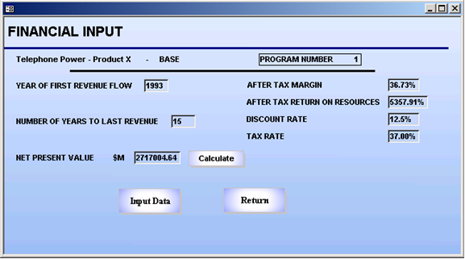

Slide 43
Strategic Planning and New Product Development
Strategic Alignment Input Data
Strategic Alignment – This variable measures alignment with our initiative to provide value added offerings in the aerospace, telecommunication and power markets. A program in these areas rates a ‘5’. Programs in low price competition or other areas are rated lower.

Slide 44
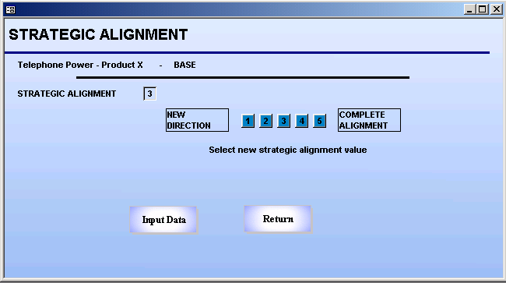

Slide 45
Strategic Planning and New Product Development
Probability of Success Input Data
Probability of Technical Success – Enter the probability that all technical goals will be met.
Probability of Commercial Success – Enter the probability that all commercial (financial and non-financial) objectives will be met.

Slide 46
Strategic Planning and New Product Development
Gate Authorizations
This application uses a stage gate process where different levels of authorization are set for each stage.
The user has the ability to set the stage authorization, the date, the dollar amount of authorization, and the status for each program.
The program needed to pass each gate sequentially.

Slide 47
Strategic Planning and New Product Development
Gate Authorizations
When a stage gate was selected, this program was compared with all other programs at this gate throughout the system.
When the authorization was changed between gates, the rankings of the programs in the gates were re-calculated since programs had changed gates.

Slide 48
Strategic Planning and New Product Development
Criteria Weights
The functionality of this section is another critical aspect of developing a decision model that reflects the various goals of an organization.
It is also a way to insure decisions reflect these goals at all levels. The high level and sub level criteria show the means by which an organization looked to evaluate their research and development programs.
The importance of the high level and sub level criteria, however, is not equal.

Slide 49
Strategic Planning and New Product Development
Criteria Weights
Market and Finance may have the highest level of importance at one point in time while Probability of Success and Competitive Position may have the highest level of importance at another point in time.
Decision criteria importance may also differ at different stages of the development process which is why the stage-gate concept was included in the system.

Slide 50
Strategic Planning and New Product Development
Criteria Weights
Decision makers must have the ability to change the importance of their objectives as the corporate climate changes and this ability should be reflected in the decision model.
This section describes some methodologies that can be used to aid decision makers in assigning their importance weighting for the objectives and decision criteria.
These weights will then be used in the ranking program and ultimately reflected in the program ranking generated by the system.

Slide 51
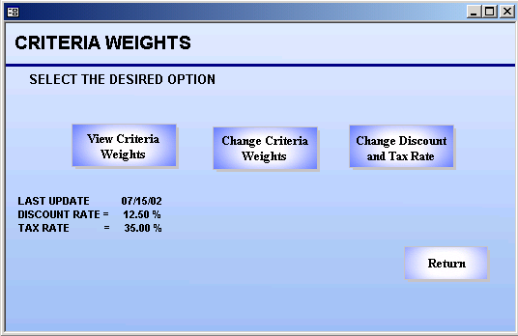

Slide 52
Strategic Planning and New Product Development
View Weights
The View Weights option displays all the criteria and their weights. In this application, the user first must decide which set of weights to view, the overall weights or those for a specific gate.
The weighting scheme in this application is a hierarchical weighting scheme with major criteria branches and sub-criteria branches under the major criteria.
These major criteria and sub-criteria are the same criteria that are used to evaluate each program.
The overall weight is the multiplication of the major criteria weight and the sub-criteria weight.
The overall weight is used in the ranking procedure for each criteria.

Slide 53
Strategic Planning and New Product Development
View Weights
Each set of criteria is weighted together.
The major criteria are weighted against each other.
The sub-criteria under each major branch are weighted against each other.
The weights on each branch of the tree are normalized to 1 and are normalized whenever the weights are changed.
As a note, no matter what the weight of a sub-criteria is, its importance cannot be greater that the major criteria weight.

Slide 54
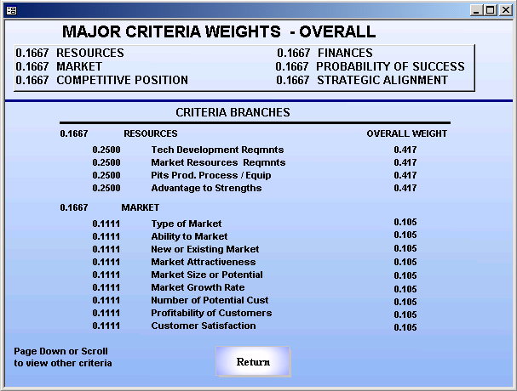

Slide 55
Strategic Planning and New Product Development
Change Weights
In this application, weights may be changed overall or for a specific gate.
Weights may be changed for the six major branches and for the sub-criteria under each of the major branches.
The entered weights and the normalized weights are displayed for the group of criteria that has been selected for change.

Slide 56
Strategic Planning and New Product Development
Edit Weights
Different methods of weighting the decision criteria can be used including
D:Direct
S:Scale
P:Pairwise Comparison
M:Max/Min option is used to display which criteria are maximized or minimized.
These different methods of weighting decision criteria are included to facilitate the decision maker in establishing the criteria importance

Slide 57
Strategic Planning and New Product Development
Direct
Direct weighting is a simple, intuitive approach to weighting decision criteria.
Decision makers simply use a 0 to 10 scale, where 0 equals No Importance and 10 equals Absolute Importance to indicate the importance of the criteria.
Once the importance weighting is entered, the values are normalized to equal 1.

Slide 58
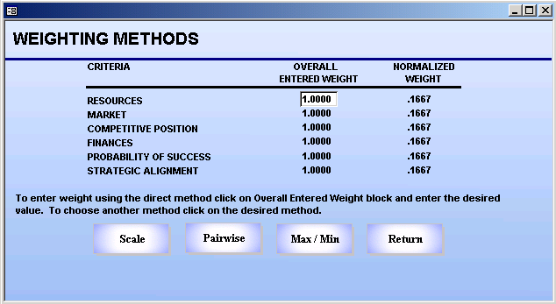

Slide 59
Strategic Planning and New Product Development
Scale
A visual scale can also be used to enter the weights for the criteria.
The same type of normalization process is used as is used with the direct weighting once the values for all of the criteria are entered.

Slide 60
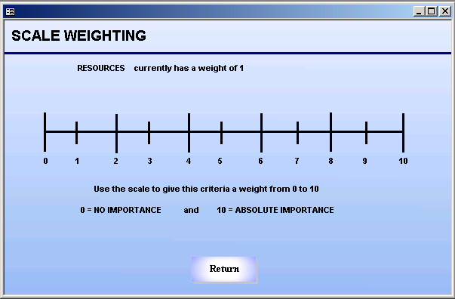

Slide 61
Strategic Planning and New Product Development
Pairwise Comparison
The Eigenvector Pairwise Comparison method calculates the weights based on subjective comparison of one criteria to another.
This method is useful if one is uncertain on the assignment of the weights for each criteria.
Each of the criteria in the criteria group is compared to each other using this method.
This process will continue through each pair of criteria.
If the decision maker does not like these weights, they can then be modified using another weighting method.

Slide 62
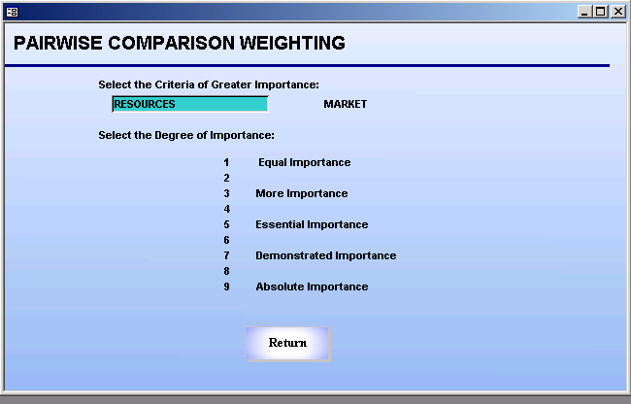

Slide 63
Strategic Planning and New Product Development
Maximize/Minimize
The Maximize/Minimize option tell whether “bigger is better” or “smaller is better” for each of the decision criteria.
With some criteria, a higher value is a better score.
With other criteria a lower value is a better score.
Having this option provides the decision maker with the ability to view criteria evaluations in a way that is most intuitive to those inputting the criteria values.
This information is used in the ranking algorithm to determine how close a program is to the best possible solution.
These values are very critical to the ranking methodology.

Slide 64
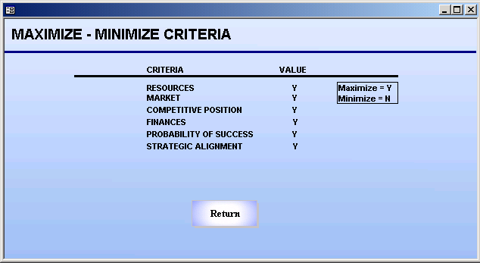

Slide 65
Strategic Planning and New Product Development
Change Discount and Tax Rate
This option allows the user to change the discount and tax rates.
The discount and tax rate can be changed to a value between 0 - 99.99%.
The new rates are used in the net present value calculations.

Slide 66
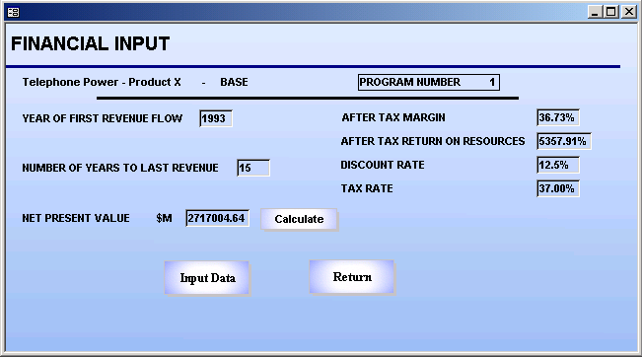

Slide 67
Strategic Planning and New Product Development
Ranking Programs
The Ranking Option in this application is used to rank the development programs.
These programs can be ranked at a specified gate or ranked overall.
The ranking algorithm used in this application (TOPSIS) uses the program evaluations made with the decision criteria and the importance weighting of the decision criteria to generate a ranked list of programs.
The scores are relative to the other programs in the data set.

Slide 68
Strategic Planning and New Product Development
Ranking Programs
The scores are determined from the values entered for each of the criteria and the individual weight on each criteria.
The ranked list is a preference order of projects.
The scores on the list are displayed to four decimal places.
The weights on the criteria could be changed to see the impact on the final ranking.
The sensitivity analysis evaluates the impact of changing the criteria inputs to the final ranking.

Slide 69
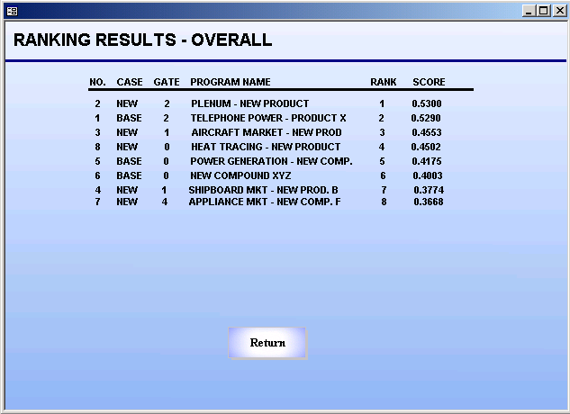

Slide 70
Strategic Planning and New Product Development
Sensitivity Analysis
This option provides decision makers with the ability to analyze the sensitivity of each program's criteria input to the ranking of the programs.
The system looks at a specific program and calculates the necessary criteria change to the inputs to move that program up or down one slot in the ranked list.
The change is calculated for each criteria independently.
Changes on some criteria will not have enough impact to change the program rank, while changes to others will.

Slide 71
Strategic Planning and New Product Development
Sensitivity Analysis
Some changes could result in the program moving more than one slot because of the relationships between the criteria weights, criteria inputs, and the range of criteria input values.
Sensitivity analysis can be used to test the impact of moving a program either up, down or both up and down in rank.
The results are displayed by criteria for each program.
There must be some differences between the programs to analyze the sensitivity.

Slide 72
Strategic Planning and New Product Development
Sensitivity Analysis
While scrolling through the list, the criteria change required to move the program up or down in rank is shown in the two top boxes on the left side of the screen
If a change within the criteria boundaries will not move the program, "NOT FEASIBLE" is displayed in the box.
Some criteria, such as Type of Market, are not sensitive to change. These are display as a "FIXED ATTRIBUTE".
In this application, a specific criteria can be selected and a new ranked program list is calculated using that new criteria input.
This displays the ranked programs using the new criteria value for the selected program. The new criteria value is listed along with the direction of movement.

Slide 73
Strategic Planning and New Product Development
Sensitivity Analysis
Since the ranking methodology is based on the relationships between the criteria weights and inputs, a change to one criteria input could affect the calculated score for every program on the list.
Since the scores are extremely sensitive to the inputs, the preference list of programs could change as these scores change.
One result of sensitivity analysis is that it points out the one or two key criteria actually driving the ranking.
If it takes a great move in criteria values to move a program rank their criteria has little affect on the ranking process.

Slide 74
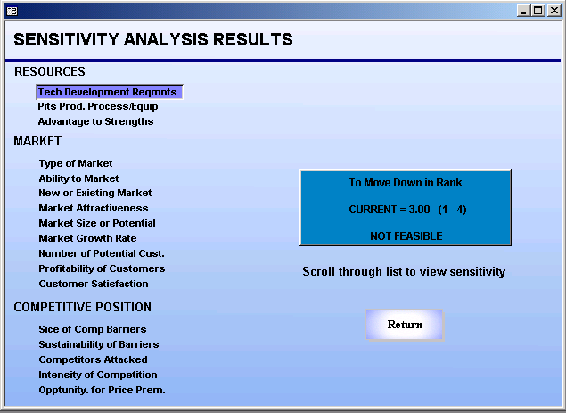

Slide 75
Strategic Planning and New Product Development
Graph NPV vs Commercial Success
This capability was provided to view a graph of the Net Present Value (NPV) vs. Probability of Commercial Success.
This provided the decision makers with a graphical look at some of the key aspects of the programs being evaluated.
The graph is divided into four quadrants that illustrate high & low NPV vs. high & low Commercial Success.

Slide 76
Strategic Planning and New Product Development
Graph NPV vs Commercial Success
The four quadrants are explained to further assist the decision maker.
Quadrant 1: These programs should be strongly evaluated. Those which show no promise of success should be dropped. Those close to quadrant 2 should be examined to check input data.
Quadrant 2: These programs provide cash flow for funding the business and longer term program development. If you’re close to quadrant 1, re-evaluate carefully. These programs are normally well along in development and should have a high level of confidence in the input data.

Slide 77
Strategic Planning and New Product Development
Graph NPV vs Commercial Success
The four quadrants are explained to further assist the decision maker.
Quadrant 3: Each business should have some of these in order to generate long term business success. Evaluate these to determine how sensitive the business is to losses in these programs.
Quadrant 4: These programs are highly desirable and should be preferentially funded.

Slide 78
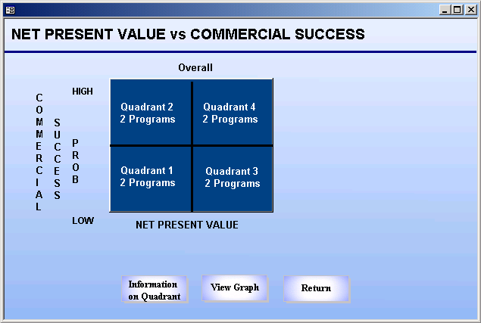

Slide 79
Strategic Planning and New Product Development
Sample Graph
Each program was represented by a star.
Both the horizontal and the vertical scales were from the lowest entered value to the highest entered value.
The cross bars intersect at the median values.
If programs fell in the center box, they should be evaluated closer because they fall very close the median values.

Slide 80
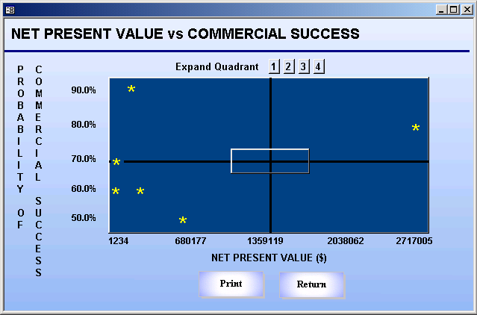

Slide 81
Strategic Planning and New Product Development
Define the Objectives and Identify Metrics
Significant time and effort was expended in the development of the objectives, decision criteria, and metrics for this application.
Senior executives were closely engaged with the decision on each criterion in that this application was used to evaluate millions of dollars worth of programs for the company.
Attention to this aspect of the model building led to the confidence in this approach and use of this methodology for numerous years.

Slide 82
Strategic Planning and New Product Development
Explore the Environment
Marketing, finance, research and development, and strategy were well integrated with this decision process.
Many of the decision criteria, using scaled evaluations, compared this company’s view of how this project would compare to their competitors in a variety of areas.
Executives in various areas of the company came together to agree on those key cross-functional aspects of a program that should be used in the program evaluation.

Slide 83
Strategic Planning and New Product Development
Explore the Scope of the Problem and Its Importance
The criteria and stage gate process used in this application were developed from a holistic perspective so that those programs moving through the development process would have a consistent evaluation process.
The ability to view programs within a stage gate and across all stage gates provided a mechanism for a holistic evaluation of research and development programs.

Slide 84
Strategic Planning and New Product Development
Explore the Scope of the Problem and Its Importance
Also, the criteria and program evaluations addressed the resources required for the program.
With this, the decision makers evaluated how the project fit within the current facilities, equipment, and personnel.
This required the decision maker to view this program from a cross-organizational perspective and assess its fit into the current operating environment.

Slide 85
Strategic Planning and New Product Development
Data Mining and Statistical Analysis
Data to support the objectives, measures, and financial calculations were reviewed in detail.
Many of the decision criteria that were developed were scaled for easy input based on the actual historical data.
Financial data was input to generate Net Present Values for the various programs as well.

Slide 86
Strategic Planning and New Product Development
Solve the Problem and Measure the Results
After understanding the approach for the company and the objectives and metrics, a computer application was developed to support the process.
This was done to capture and standardize the decision process and enable the company to perform these evaluations on an ongoing basis.

Slide 87
Strategic Planning and New Product Development
Evaluate the Results and Do Sensitivity
Sensitivity analysis was an integral part of this application.
New methodology in concert with the ranking methodology was developed so that the rank of each program could be tested against the sensitivity of each criterion in regards to the overall program ranking.
These research and development efforts can be costly and very important to a company’s future, so attention to this aspect of the decision process is key for a company’s strategic direction, innovation, and financial viability.

Slide 88
Strategic Planning and New Product Development
Benefits
A comprehensive set of corporate objectives, decision criteria, and metrics agreed upon by a cross-functional group of corporate executives to evaluate research and development programs.
A stage gate process to evaluate programs differently at each stage of their development process to determine which programs should continue with funding and which should be eliminated.
A ranking methodology that allowed for “real world” data input and evaluated programs in total and at each individual stage gate.

Slide 89
Strategic Planning and New Product Development
Benefits
Multiple methods for weighting decision criteria so that the key corporate decision makers could explore their views of the importance of the evaluation criteria.
A new approach for sensitivity analysis that enabled the decision makers to test the program rankings and re-evaluate their assessment of the programs.
An automated system that facilitated a standardized, repeatable process that could be used by the company on an ongoing basis.

Slide 90
IMSE 991 Multiple Criteria Decision Making
Lecture 11
Strategic Planning and New Product Development

